Slide 1
Robotics and Automation Presentation
By Anand Low Hong Ren

Slide 2
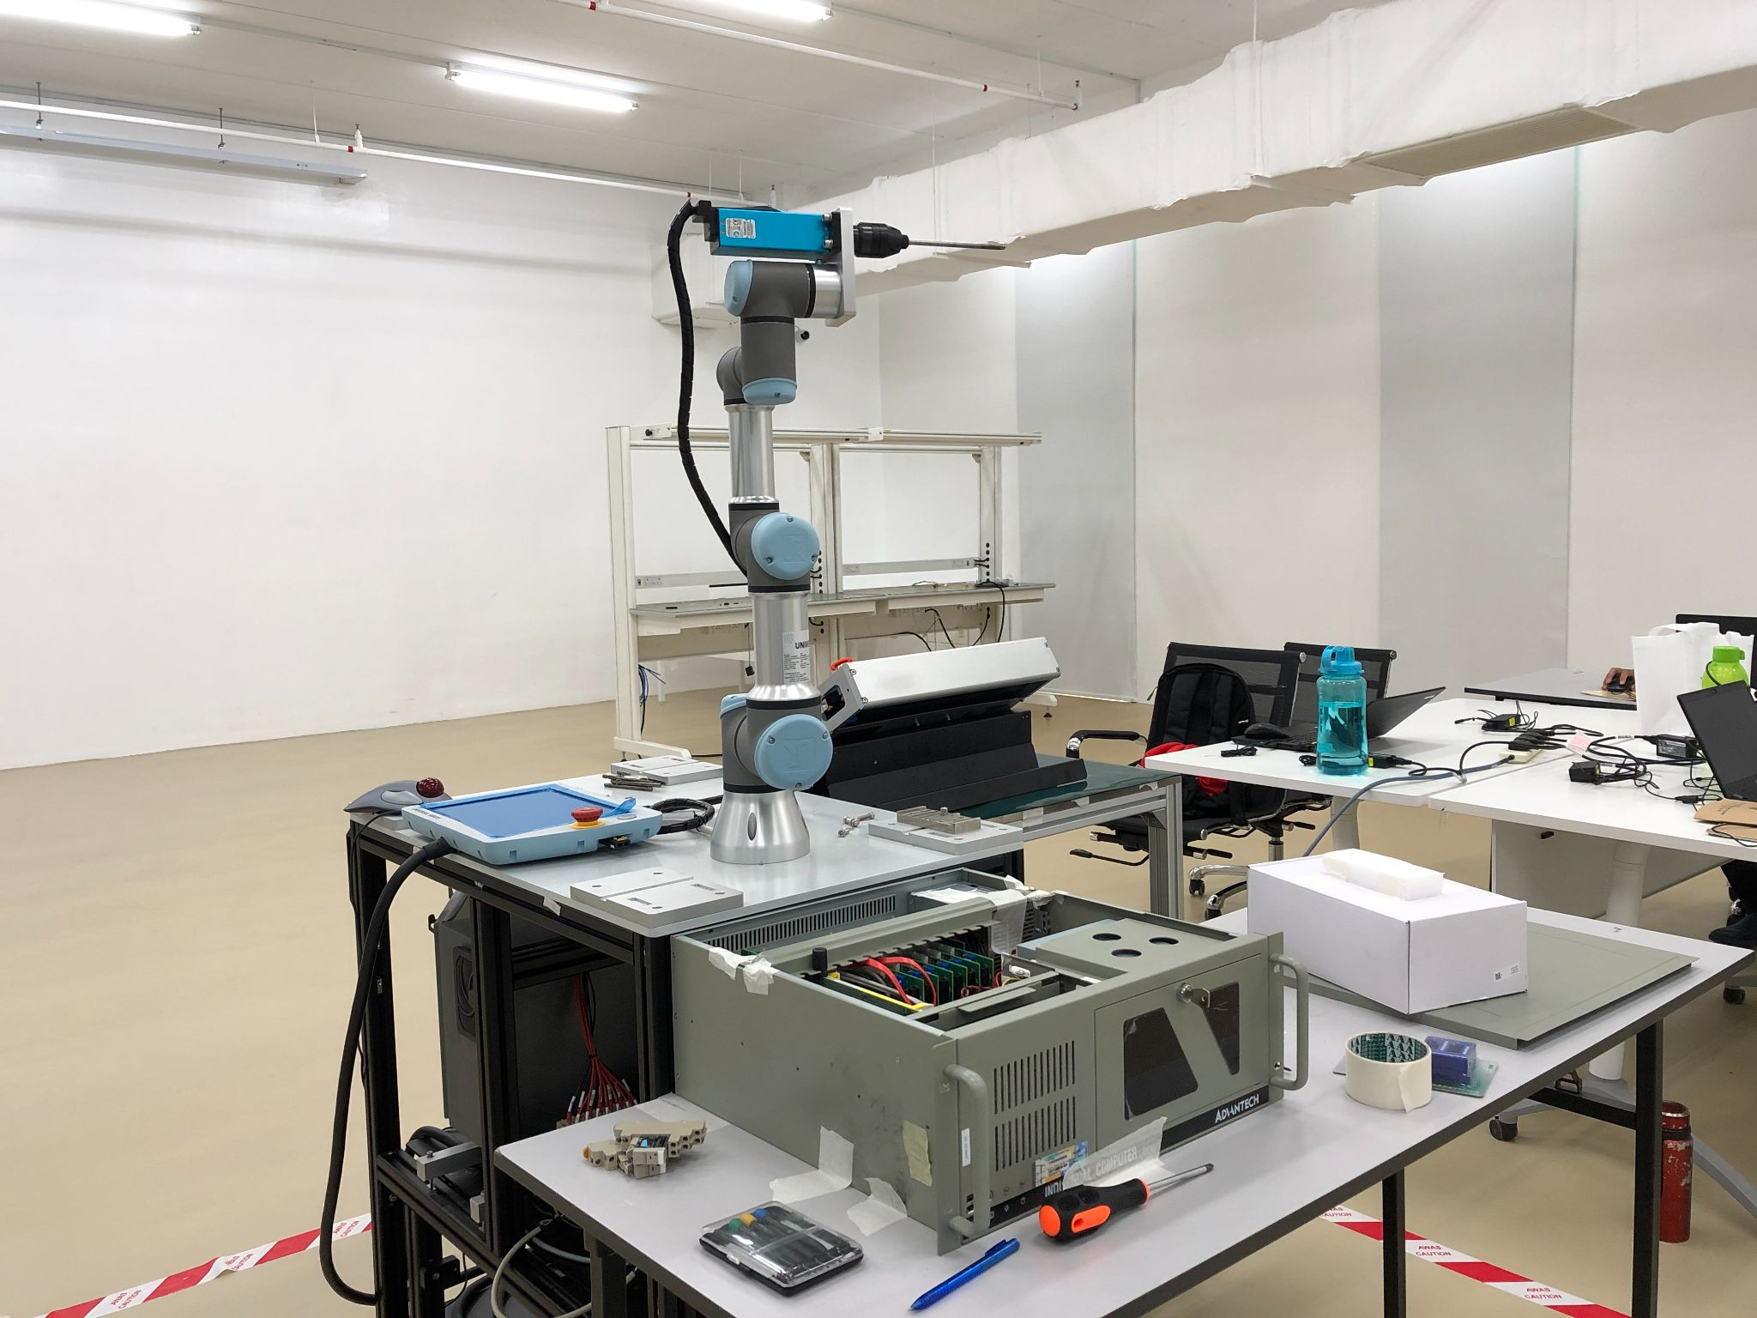
Robotic Arm and Auto Screwdriver project
Objective: To automate the screwing and unscrewing process

Slide 3
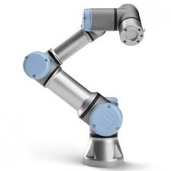
Introduction to Universal Robot UR3
Small sized tabletop 6 axis cobot
360 degree rotation on all wrist joints
Payload: 3kg and reach radius: 500mm
Speed:
MoveJ: v= 0.524 rad/s, a= 0.349 rad/sˆ2
MoveL: v=0.1 m/s, a =0.1 m/sˆ2
RM90, 000
Notes:
6 axis - more flexibility and dexterity compared to 4 axis robot
MoveJ: v= 0.524 rad/s, a= 0.349 rad/sˆ2
MoveL: v=0.1 m/s, a =0.1 m/sˆ2

Slide 4
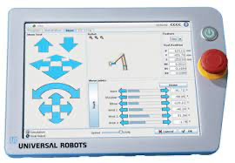
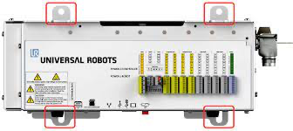
Introduction to UR teach pendant and controller box
Teach pendant:
12 inch touchscreen display
PolyScope GUI programming
Control digital, analog I/o and other safety features
Controller box
Provide digital I/O, analog I/O and USB for connection
Communicate with other devices and PLC

Slide 5
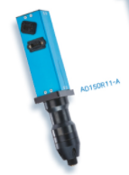
Introduction to automatic spindle
HANTAS AD150R04-A
Reliable robotic spindle system
Automate milling, grilling, drilling and screwing
Engineered for accurate and repeatable torque control
Able to use PC or PLC to control torque, speed and tightening results
RM25, 000
Model | Torque (Kfg.cm) | RPM | Weight (Kg) | Drive Size
AD150R04 | 8 ~ 60 | 100 - 1200 | 1.30 | Hex ¼”
Notes:
Borrowed by SmartTorq for two weeks

Slide 6
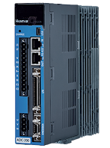
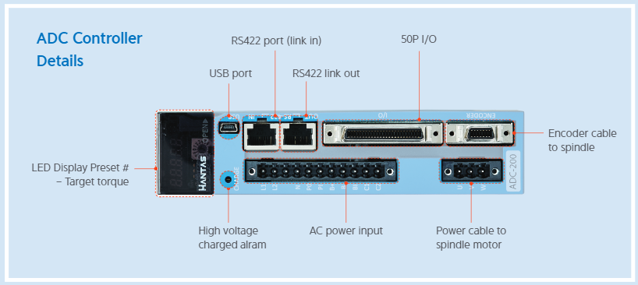
Introduction to HANTAS AD400 controller
HANTAS AD400 controller
The controller communicates between the spindle and other devices such as PLC, digital or analog input/output or PC
Control and powers the spindle

Slide 7
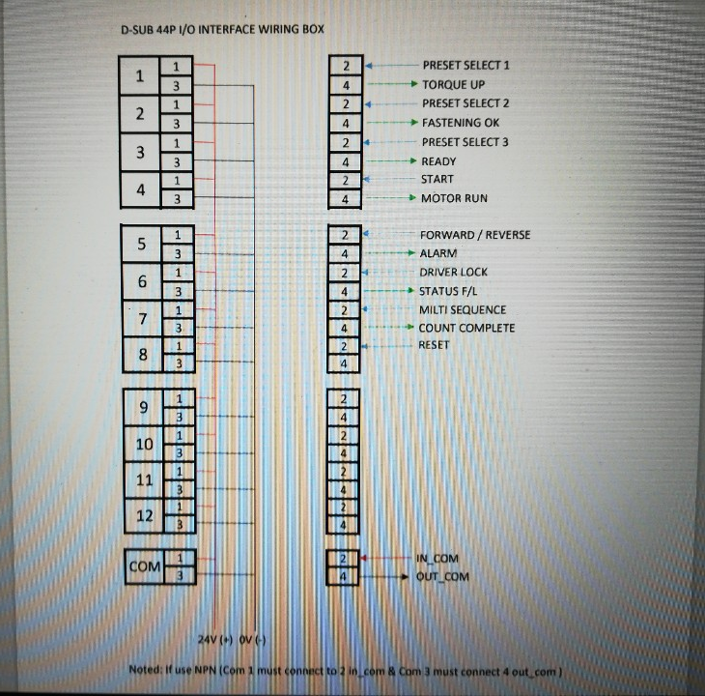
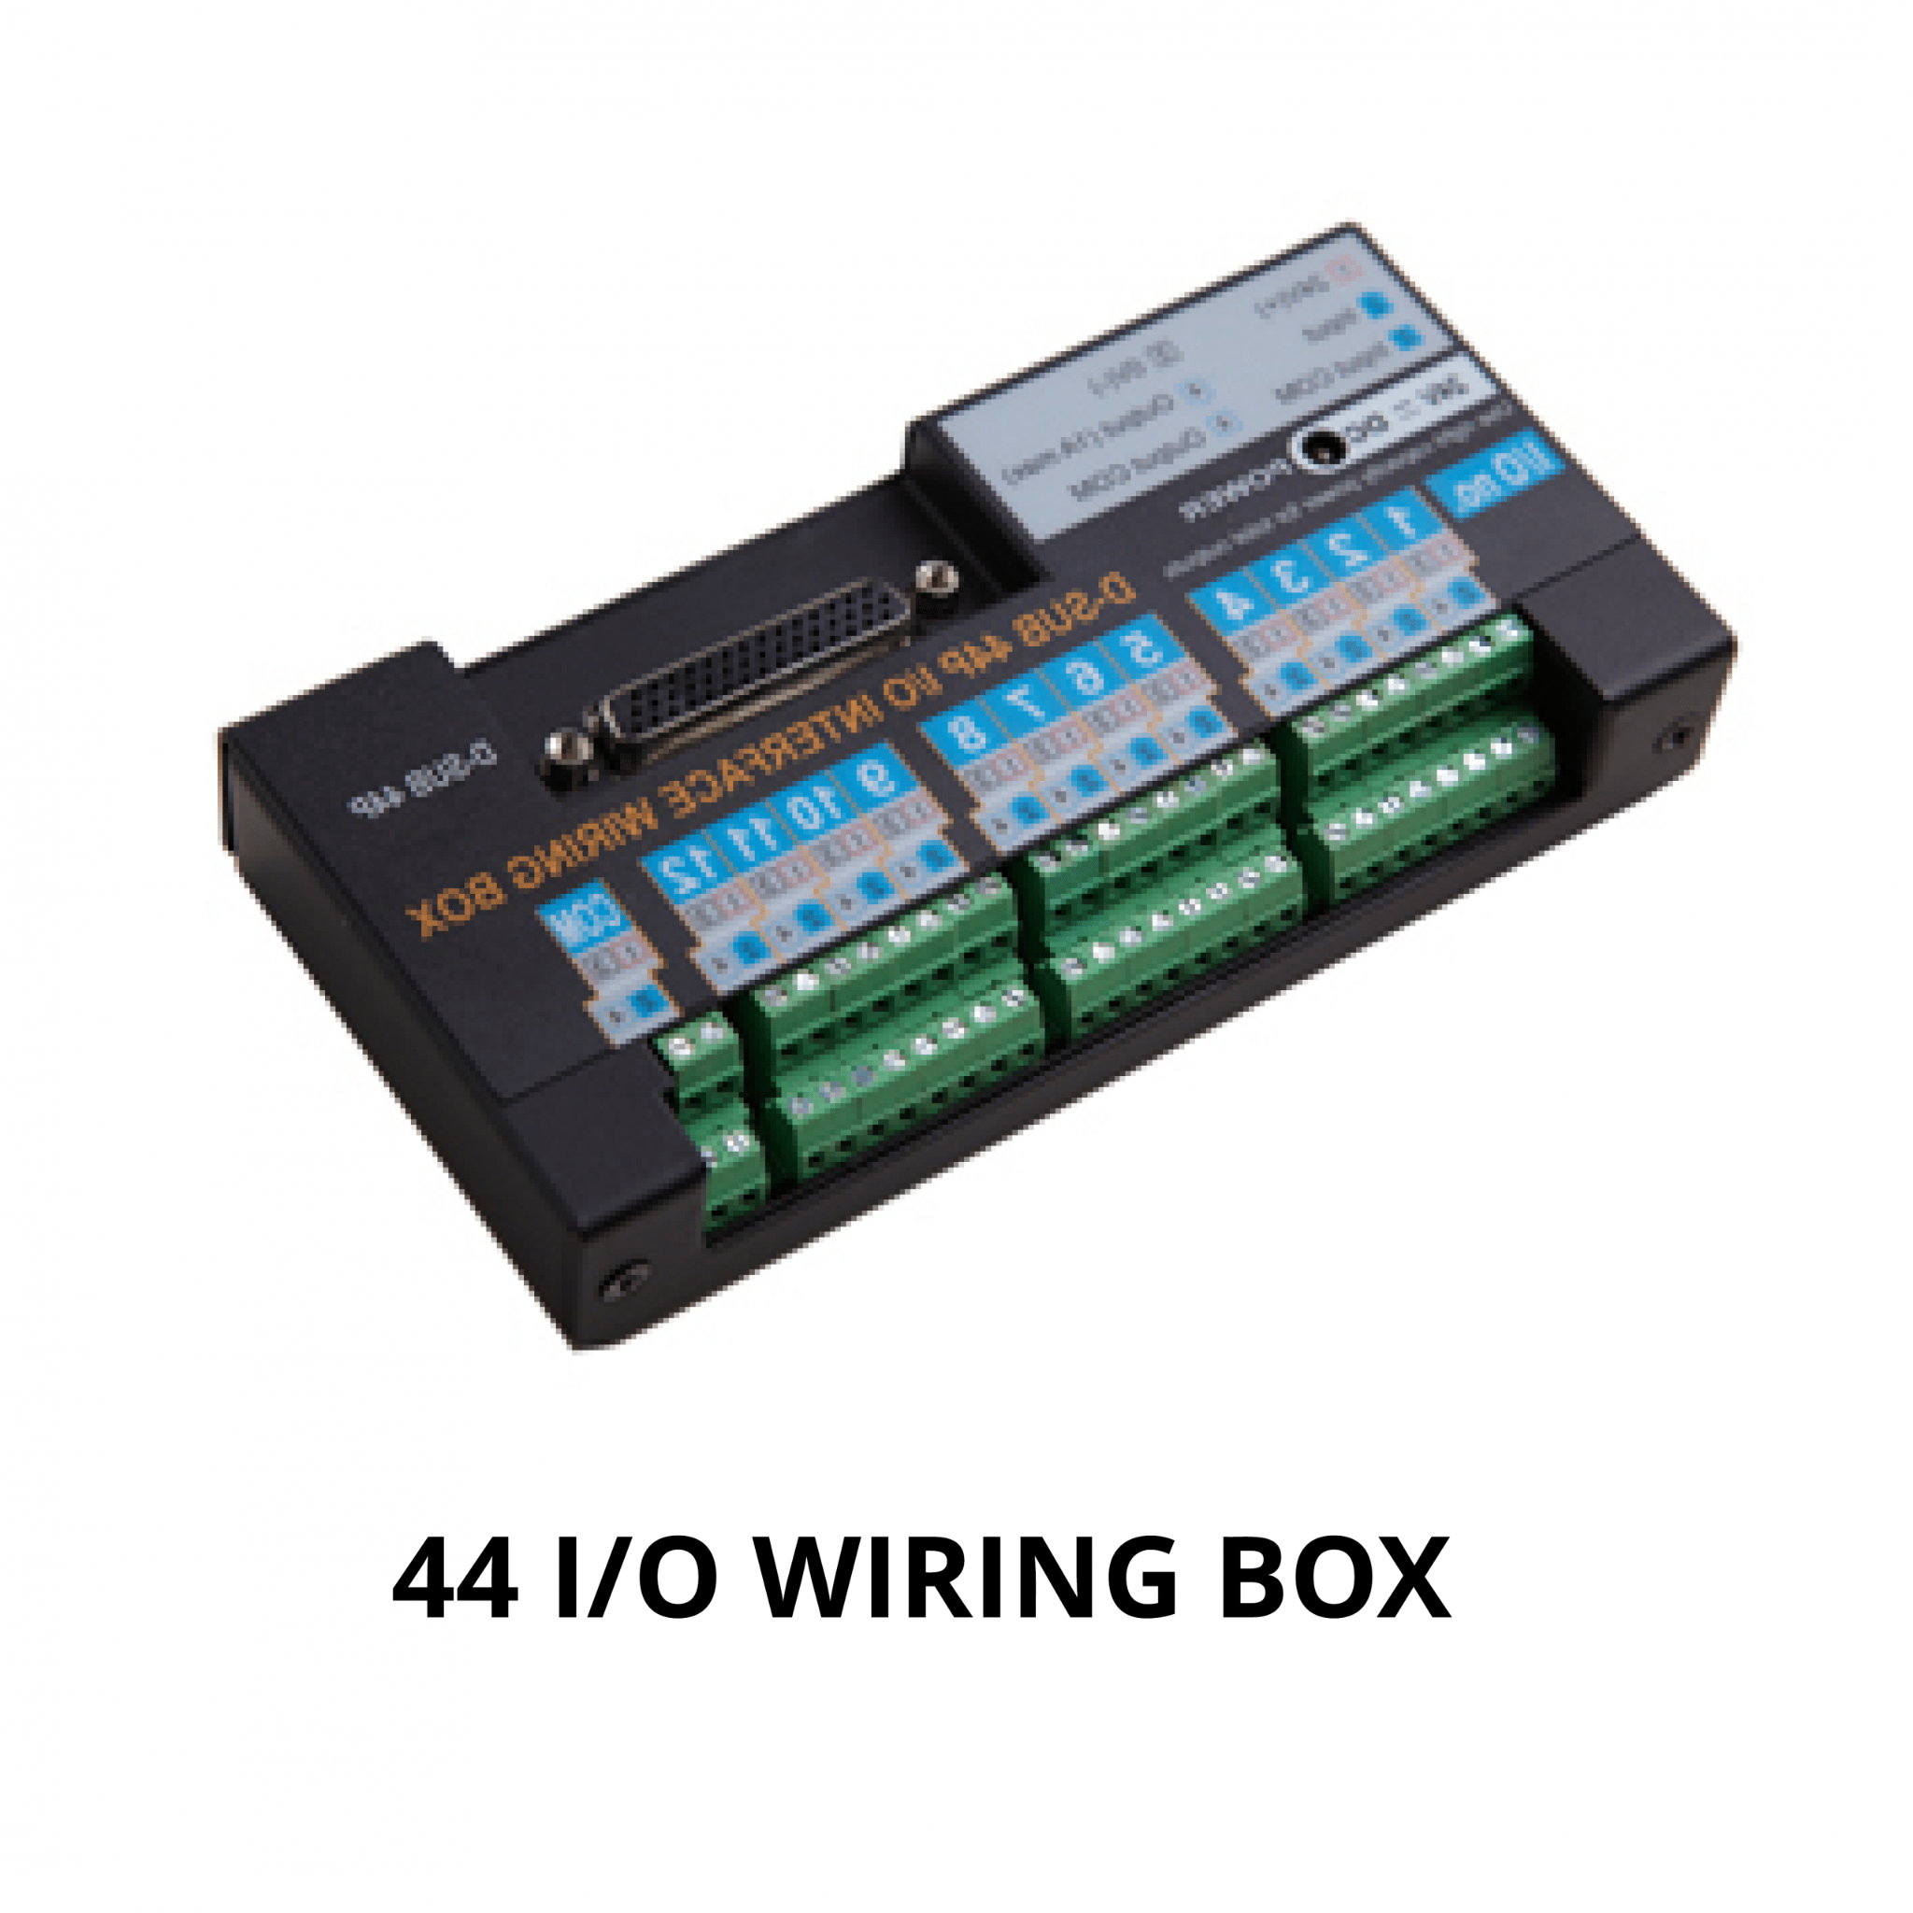
Introduction to D-SUB 44P I/O Interface wiring box

Slide 8
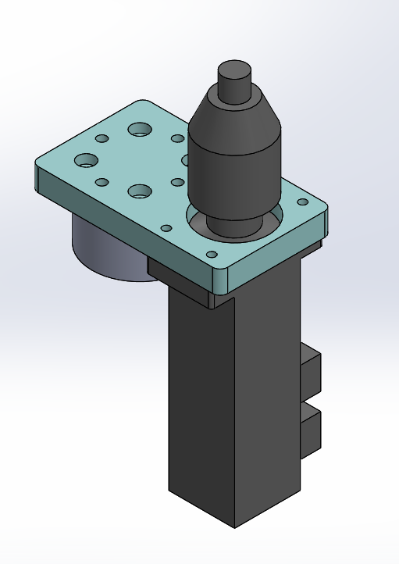
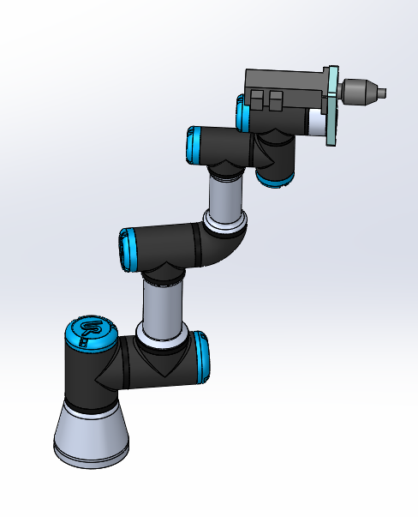
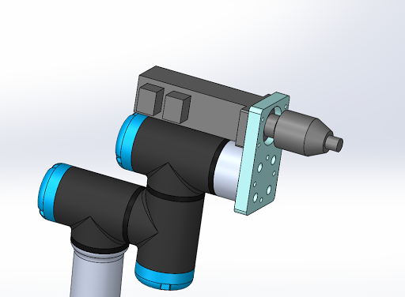
Step 1 - Metal handle to hold the tool
A metal bracket is needed to hold the automatic spindle onto the robotic arm.
Designed in SolidWork

Slide 9
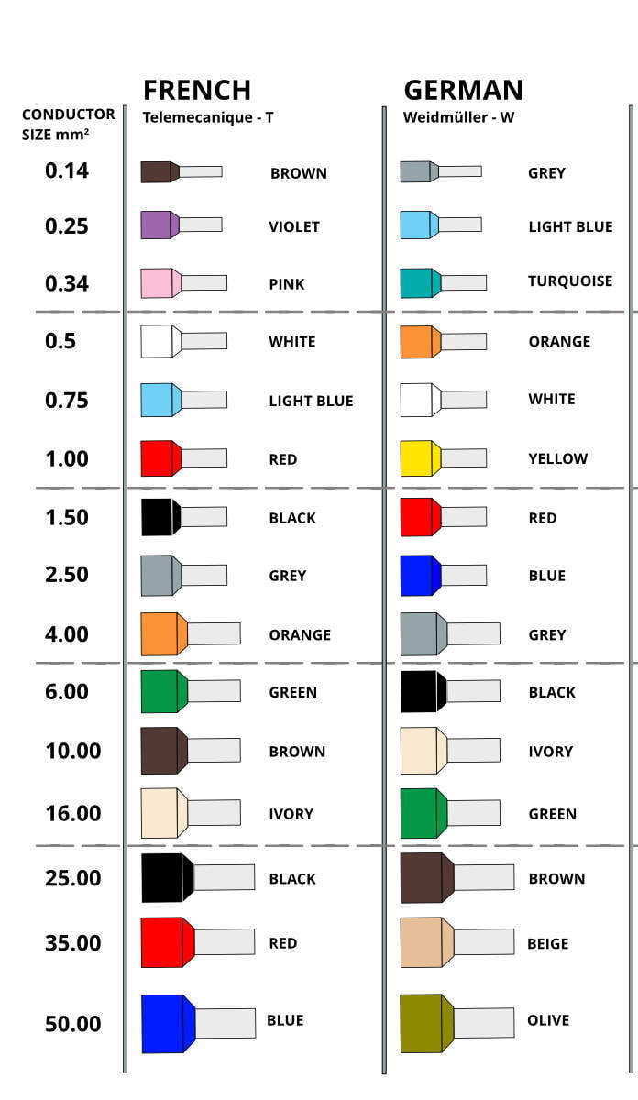
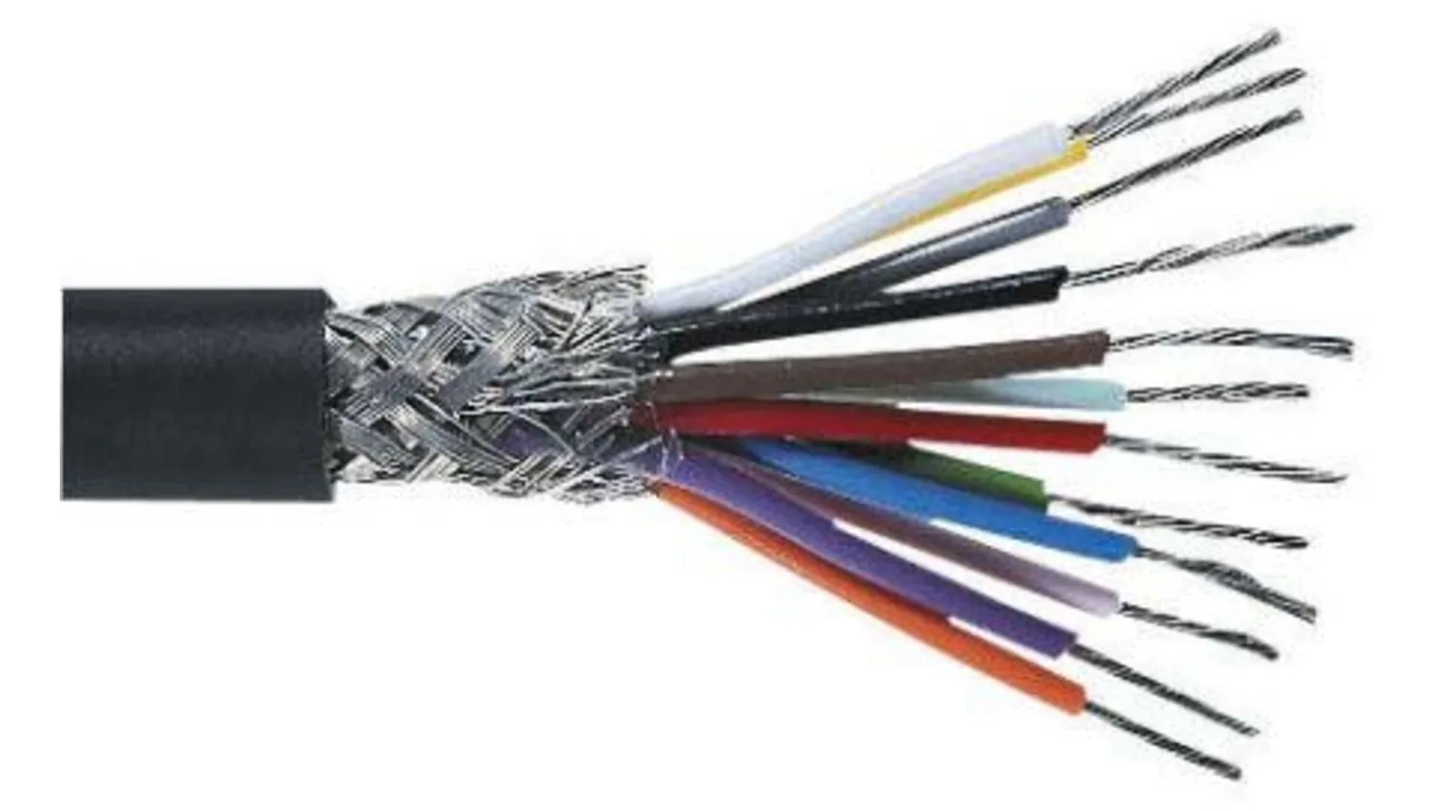
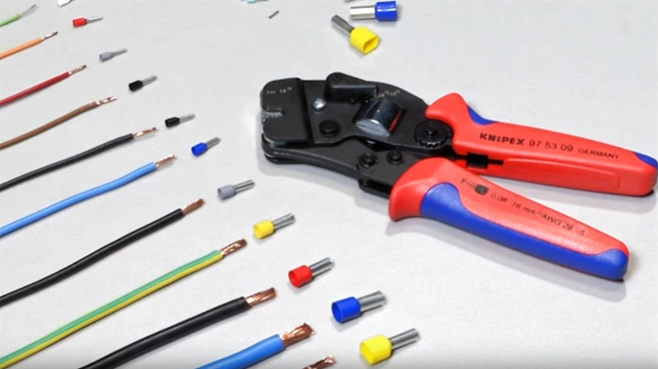
Step 2 - Cables and I/O Management
Cut the correct cable lengths
Add ferrule
Notes:
Add ferrule so that it can be plug into terminal blocks and ports with proper connection

Slide 10
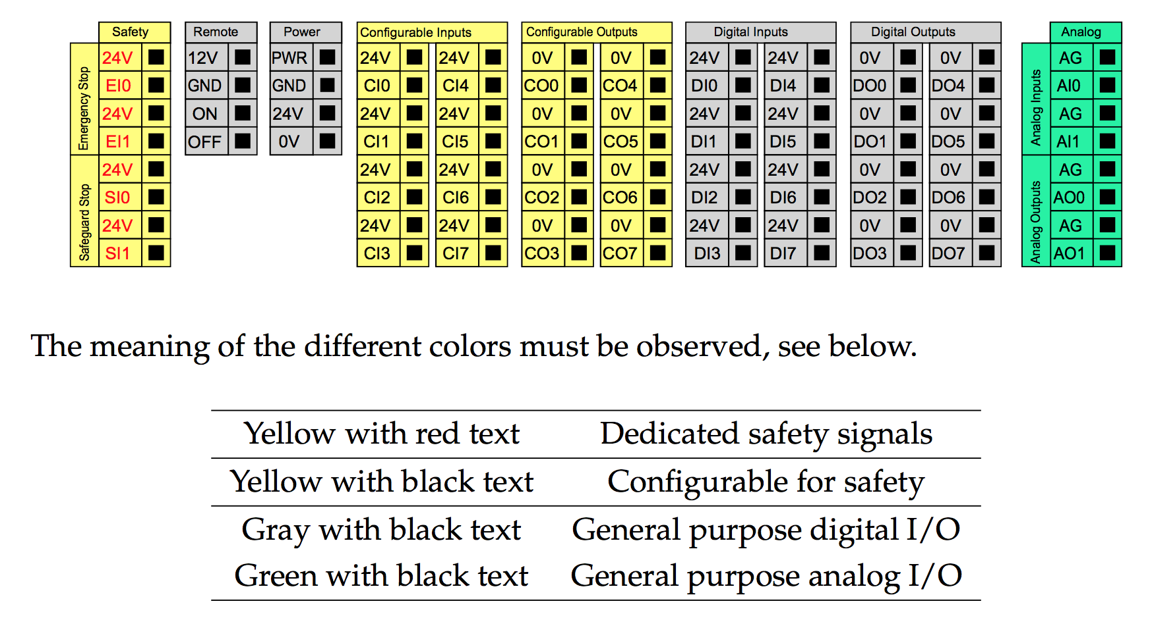
UR Controller box I/O

Slide 11
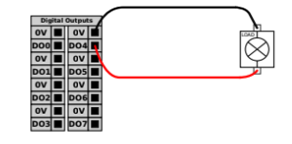
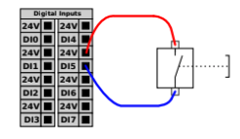
UR Digital I/O
We are only going to use digital input and output.
Figure: Load controlled by a digital output
Figure: Digital Input from a button/ relay

Slide 12
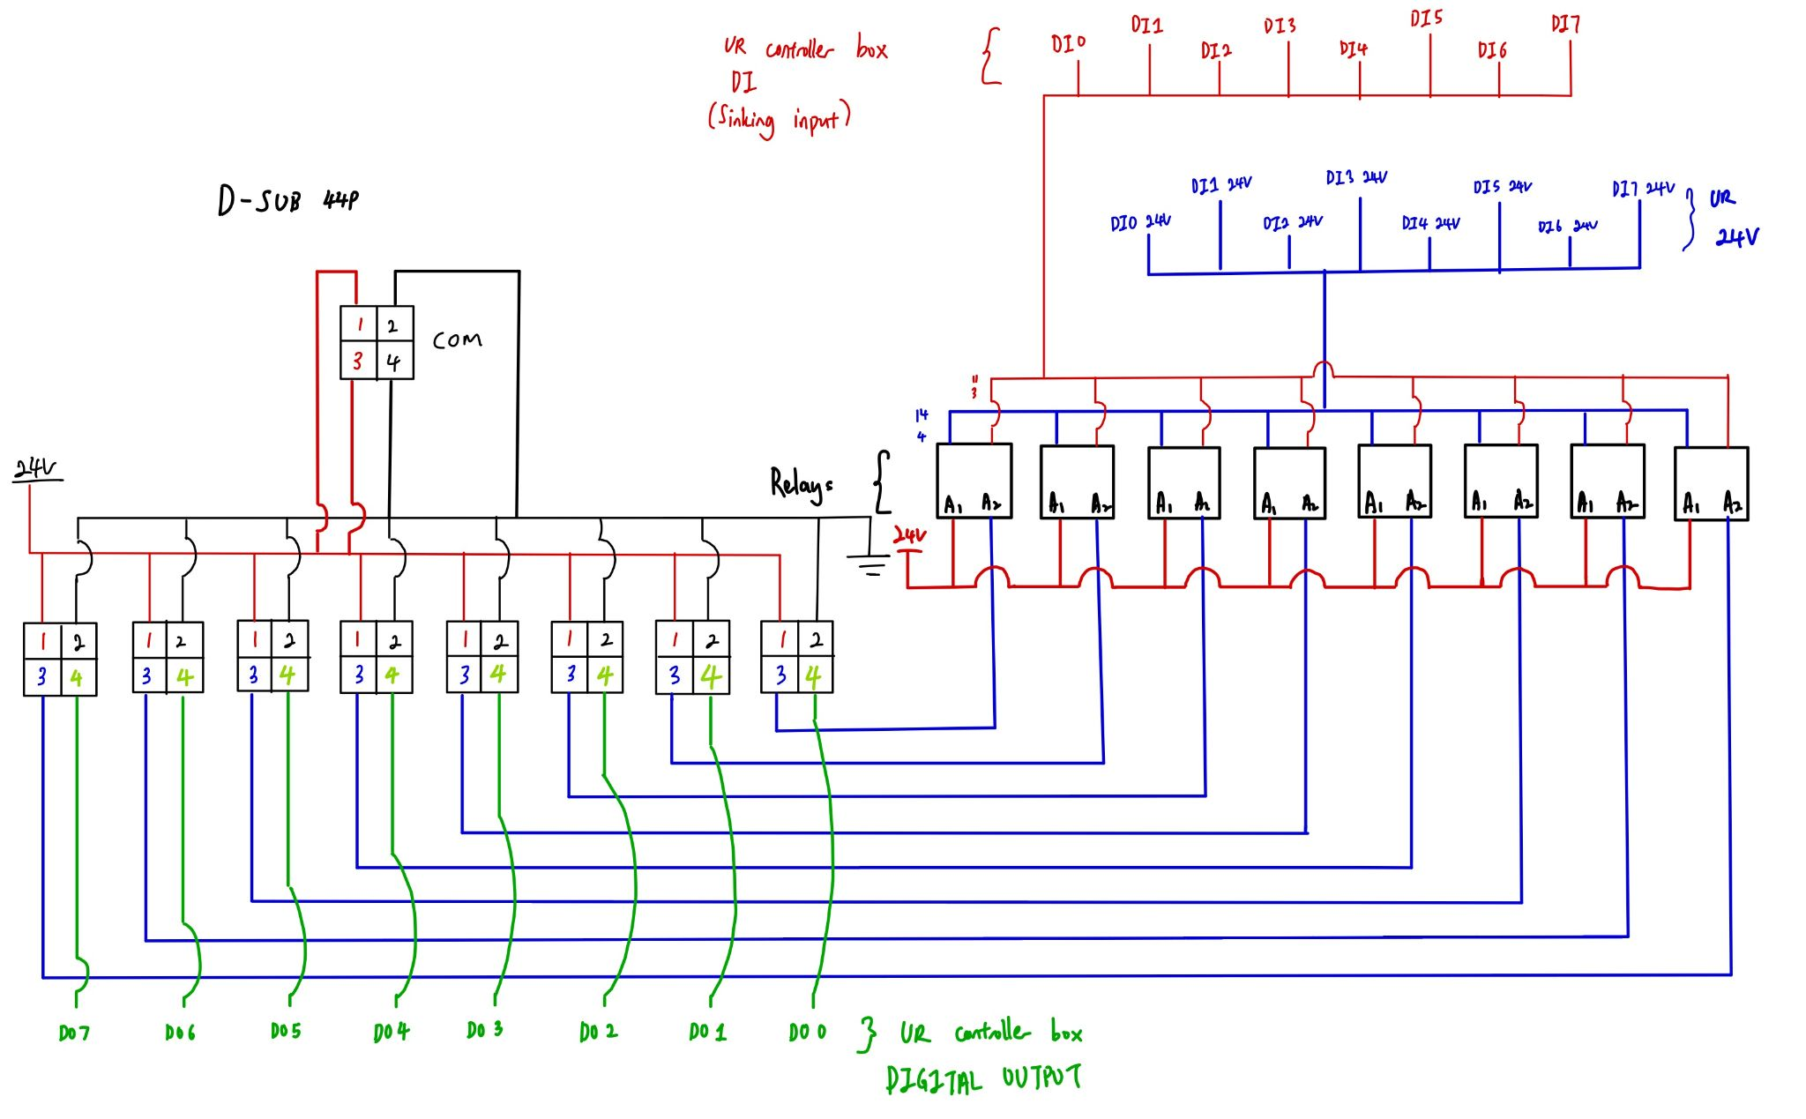
Connection Schematic

Slide 13
Connection and Functions
D-Sub 44P |  |  |  | UR Controller Box
I/O | Port | Input/ Output | Function | Port
1 | 2 | Input | PRESET SELECT 1 | DO 0
 | 4 | Output | TORQUE UP | DI 1
2 | 2 | Input | PRESET SELECT 2 | DO 1
 | 4 | Output | FASTENING OK | DI 2
3 | 2 | Input | PRESET SELECT 3 | DO 2
 | 4 | Output | READY | DI 3
4 | 2 | Input | START | DO 3
 | 4 | Output | MOTOR RUN | DI 4
5 | 2 | Input | FASTEN/LOOSEN | DO 4
 | 4 | Output | ALARM | DI 5

Slide 14
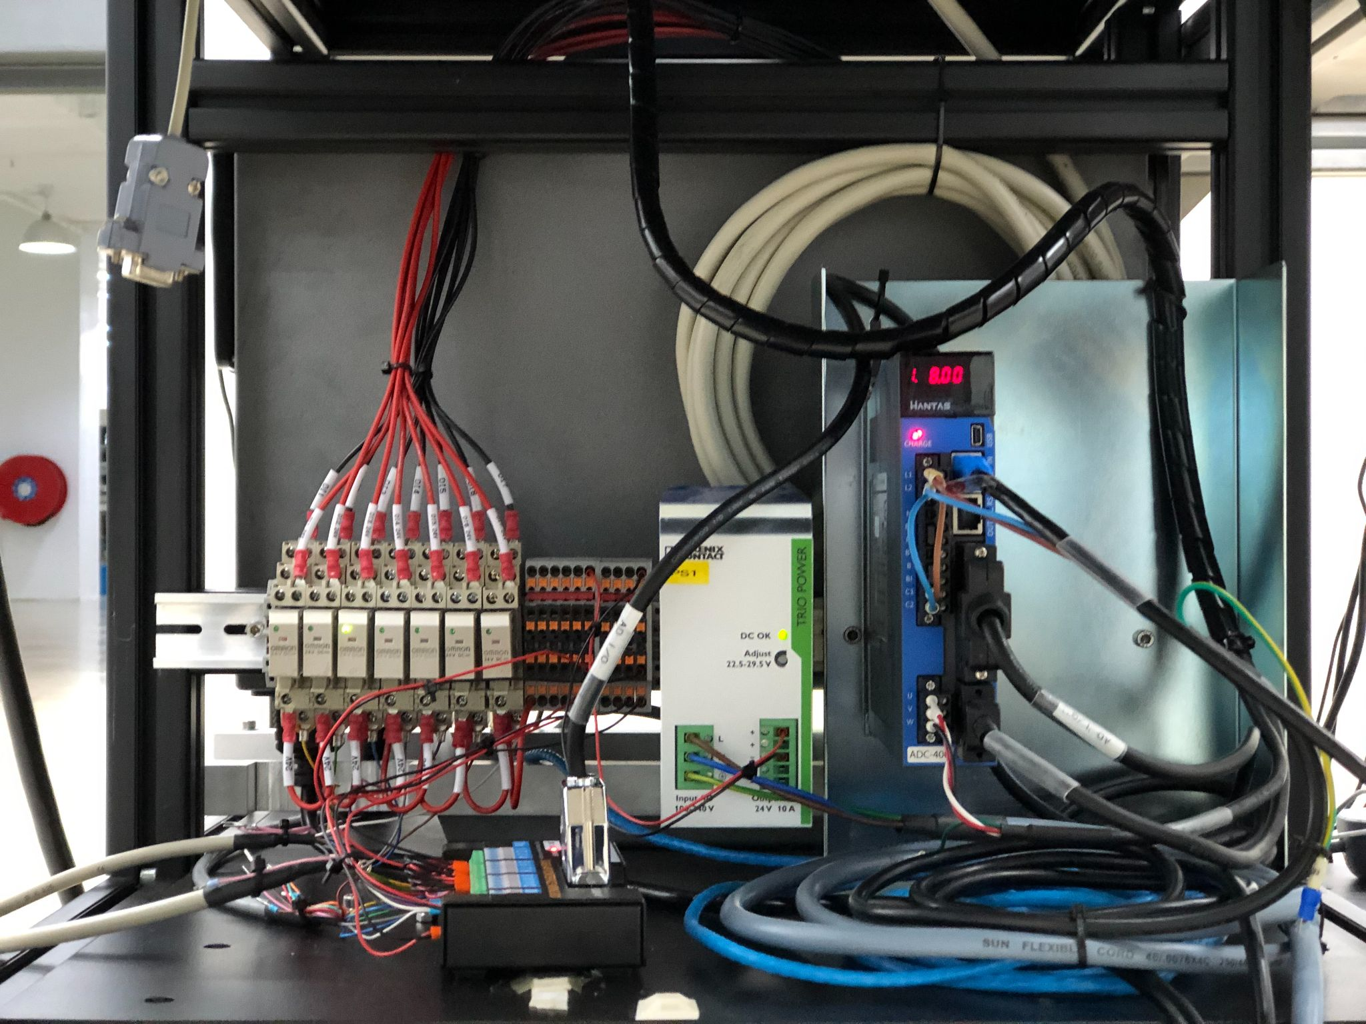
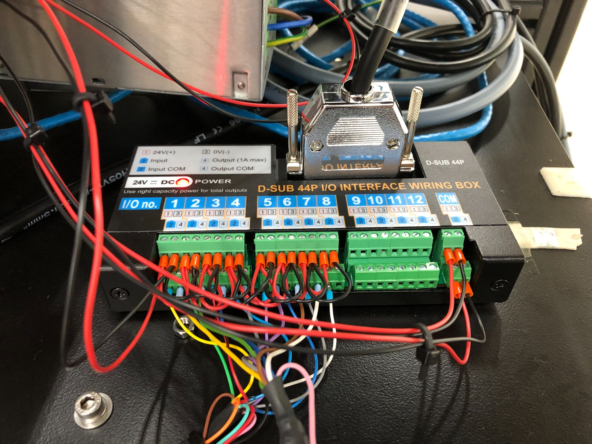
Connections
Figure: I/O wiring box, Relays, Terminal Blocks, Power Supply and AD 400 Controller
Figure: D-SUB 44P I/O Interface wiring box

Slide 15
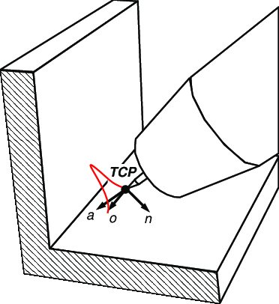
Step 3 - Set TCP, Payload and COG
Set Tool Centre Point (TCP)
If no tool is added, the end of the arm is the reference point for navigation/ TCP.
If a tool is added, it will offset the TCP.
The TCP have to be configured accurately so the machine knows where the tool points to.

Slide 16
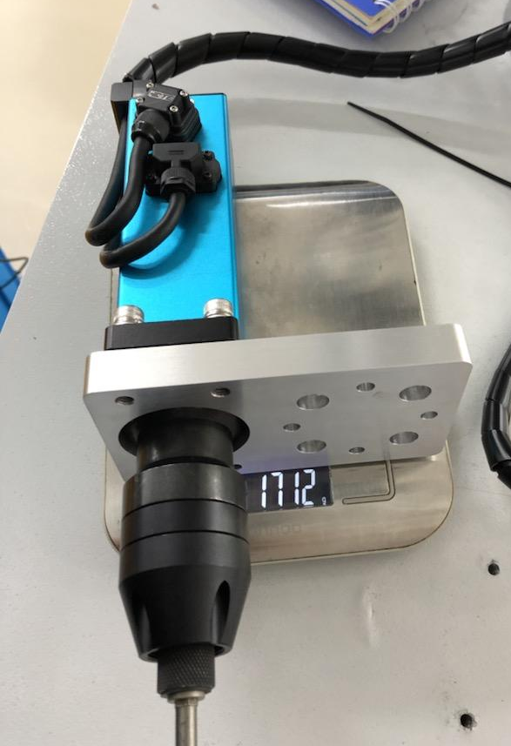
Set Payload and Centre of Gravity
Set Payload
Payload = mass of the tool
Set Centre of Gravity
The motor in the screwdriver is very heavy
The centre of gravity is set at the point of the motor
Centre of Gravity

Slide 17
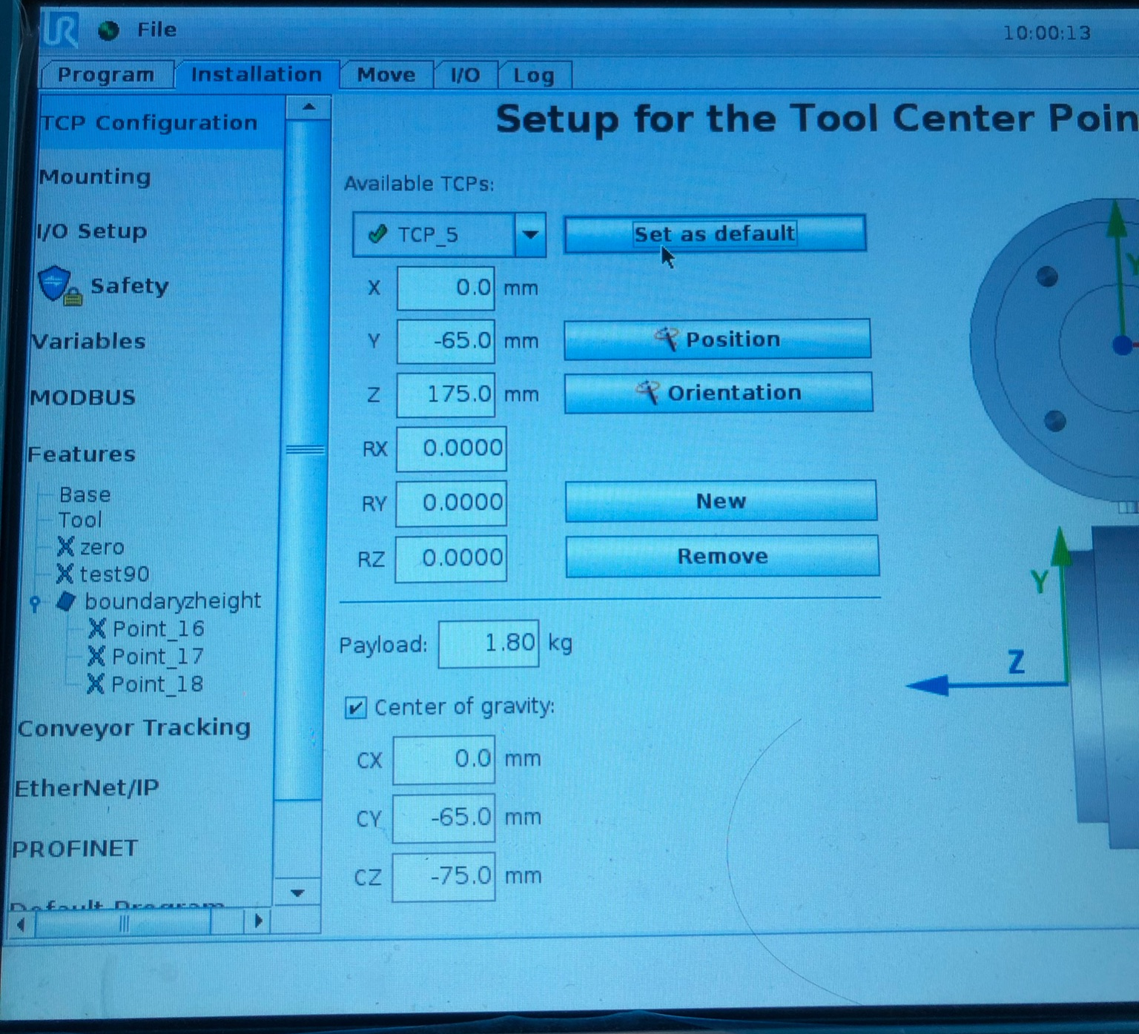
TCP, COG and Payload Settings

Slide 18
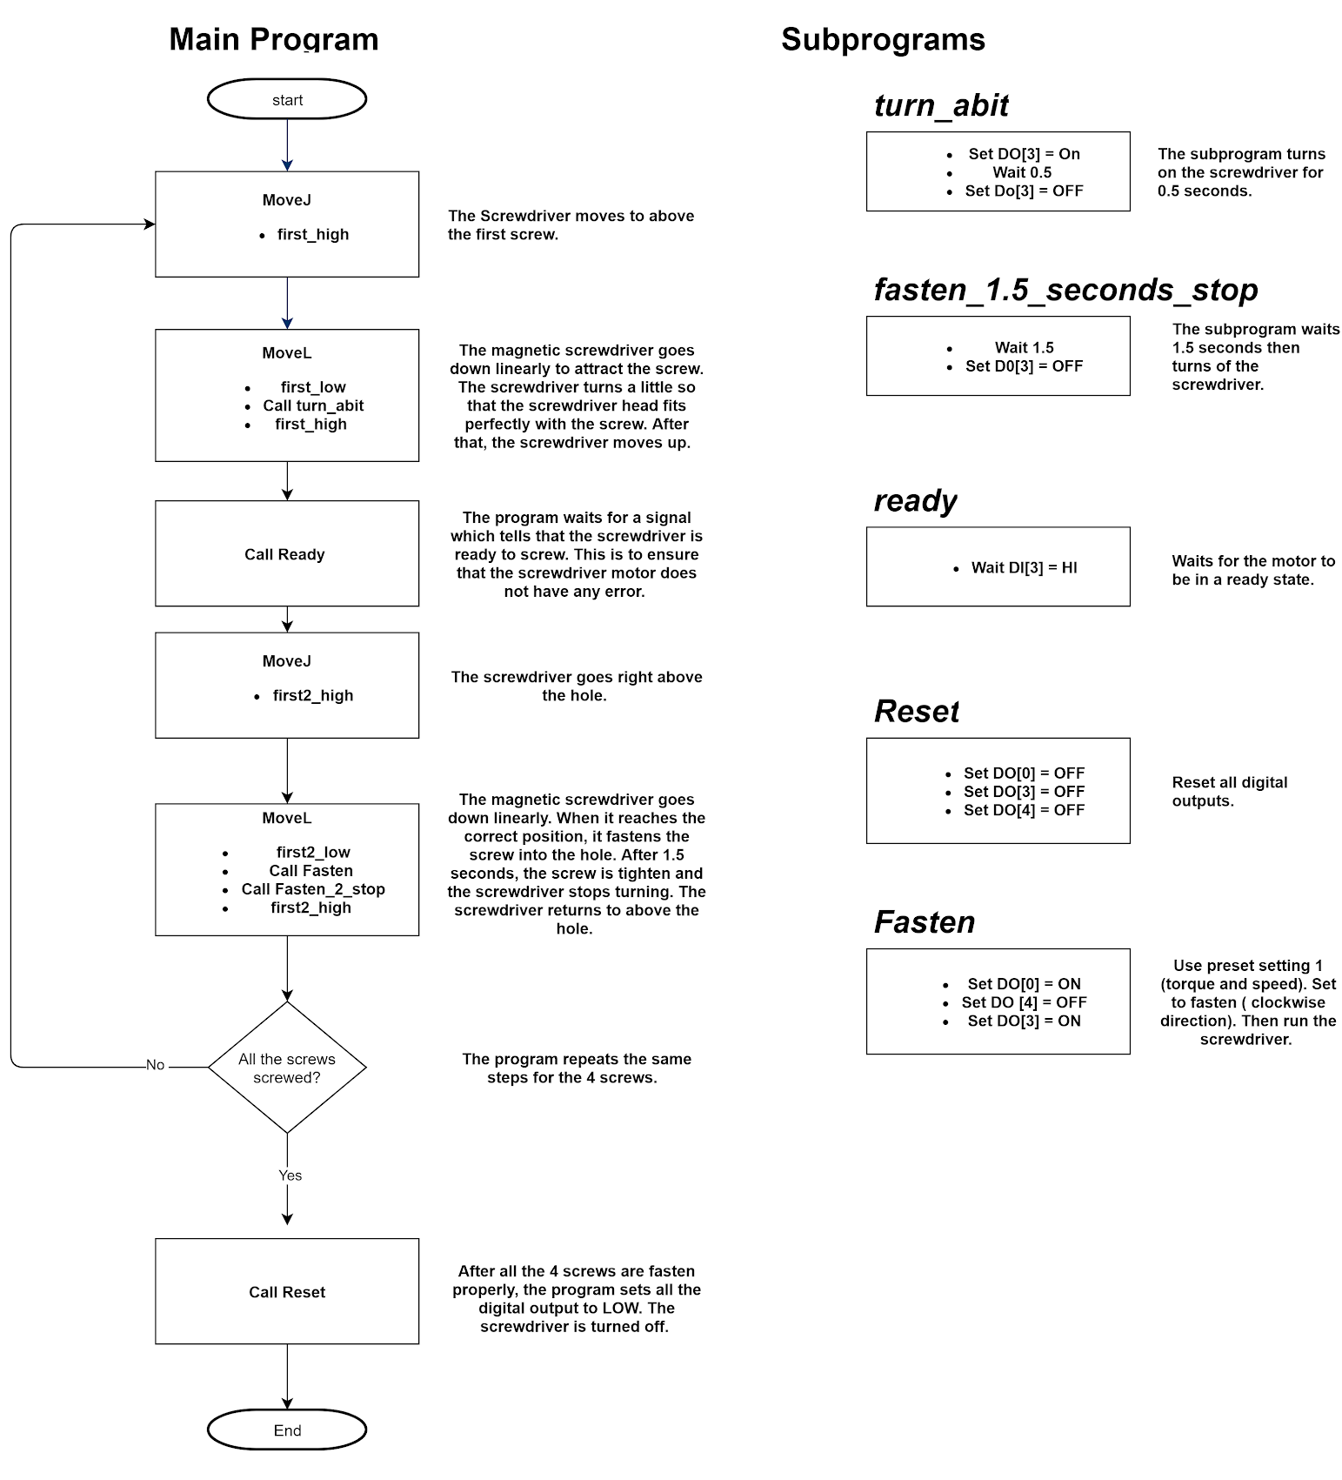
Step 4 - Programming the robot arm
Program 1 - Screw 4 screws into PC case
Every point the robot arm stops has to be set.
When the screwdriver reaches the screwing/ unscrewing position, the UR controller box will send a digital output to the screwdriver to start fastening/loosening.
After screwing/ unscrewing, the UR controller box will send another digital output signal to stop the screwdriver.
Each waypoint has to be very precise. Any inaccuracy will cause failures during the operation.

Slide 19
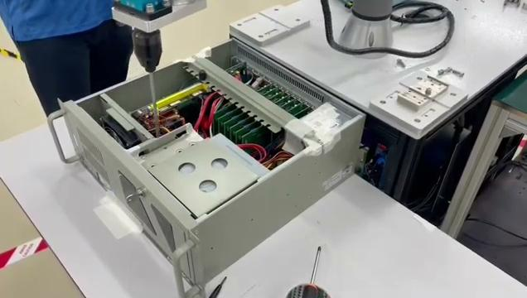
Program 1 Demo

Slide 20
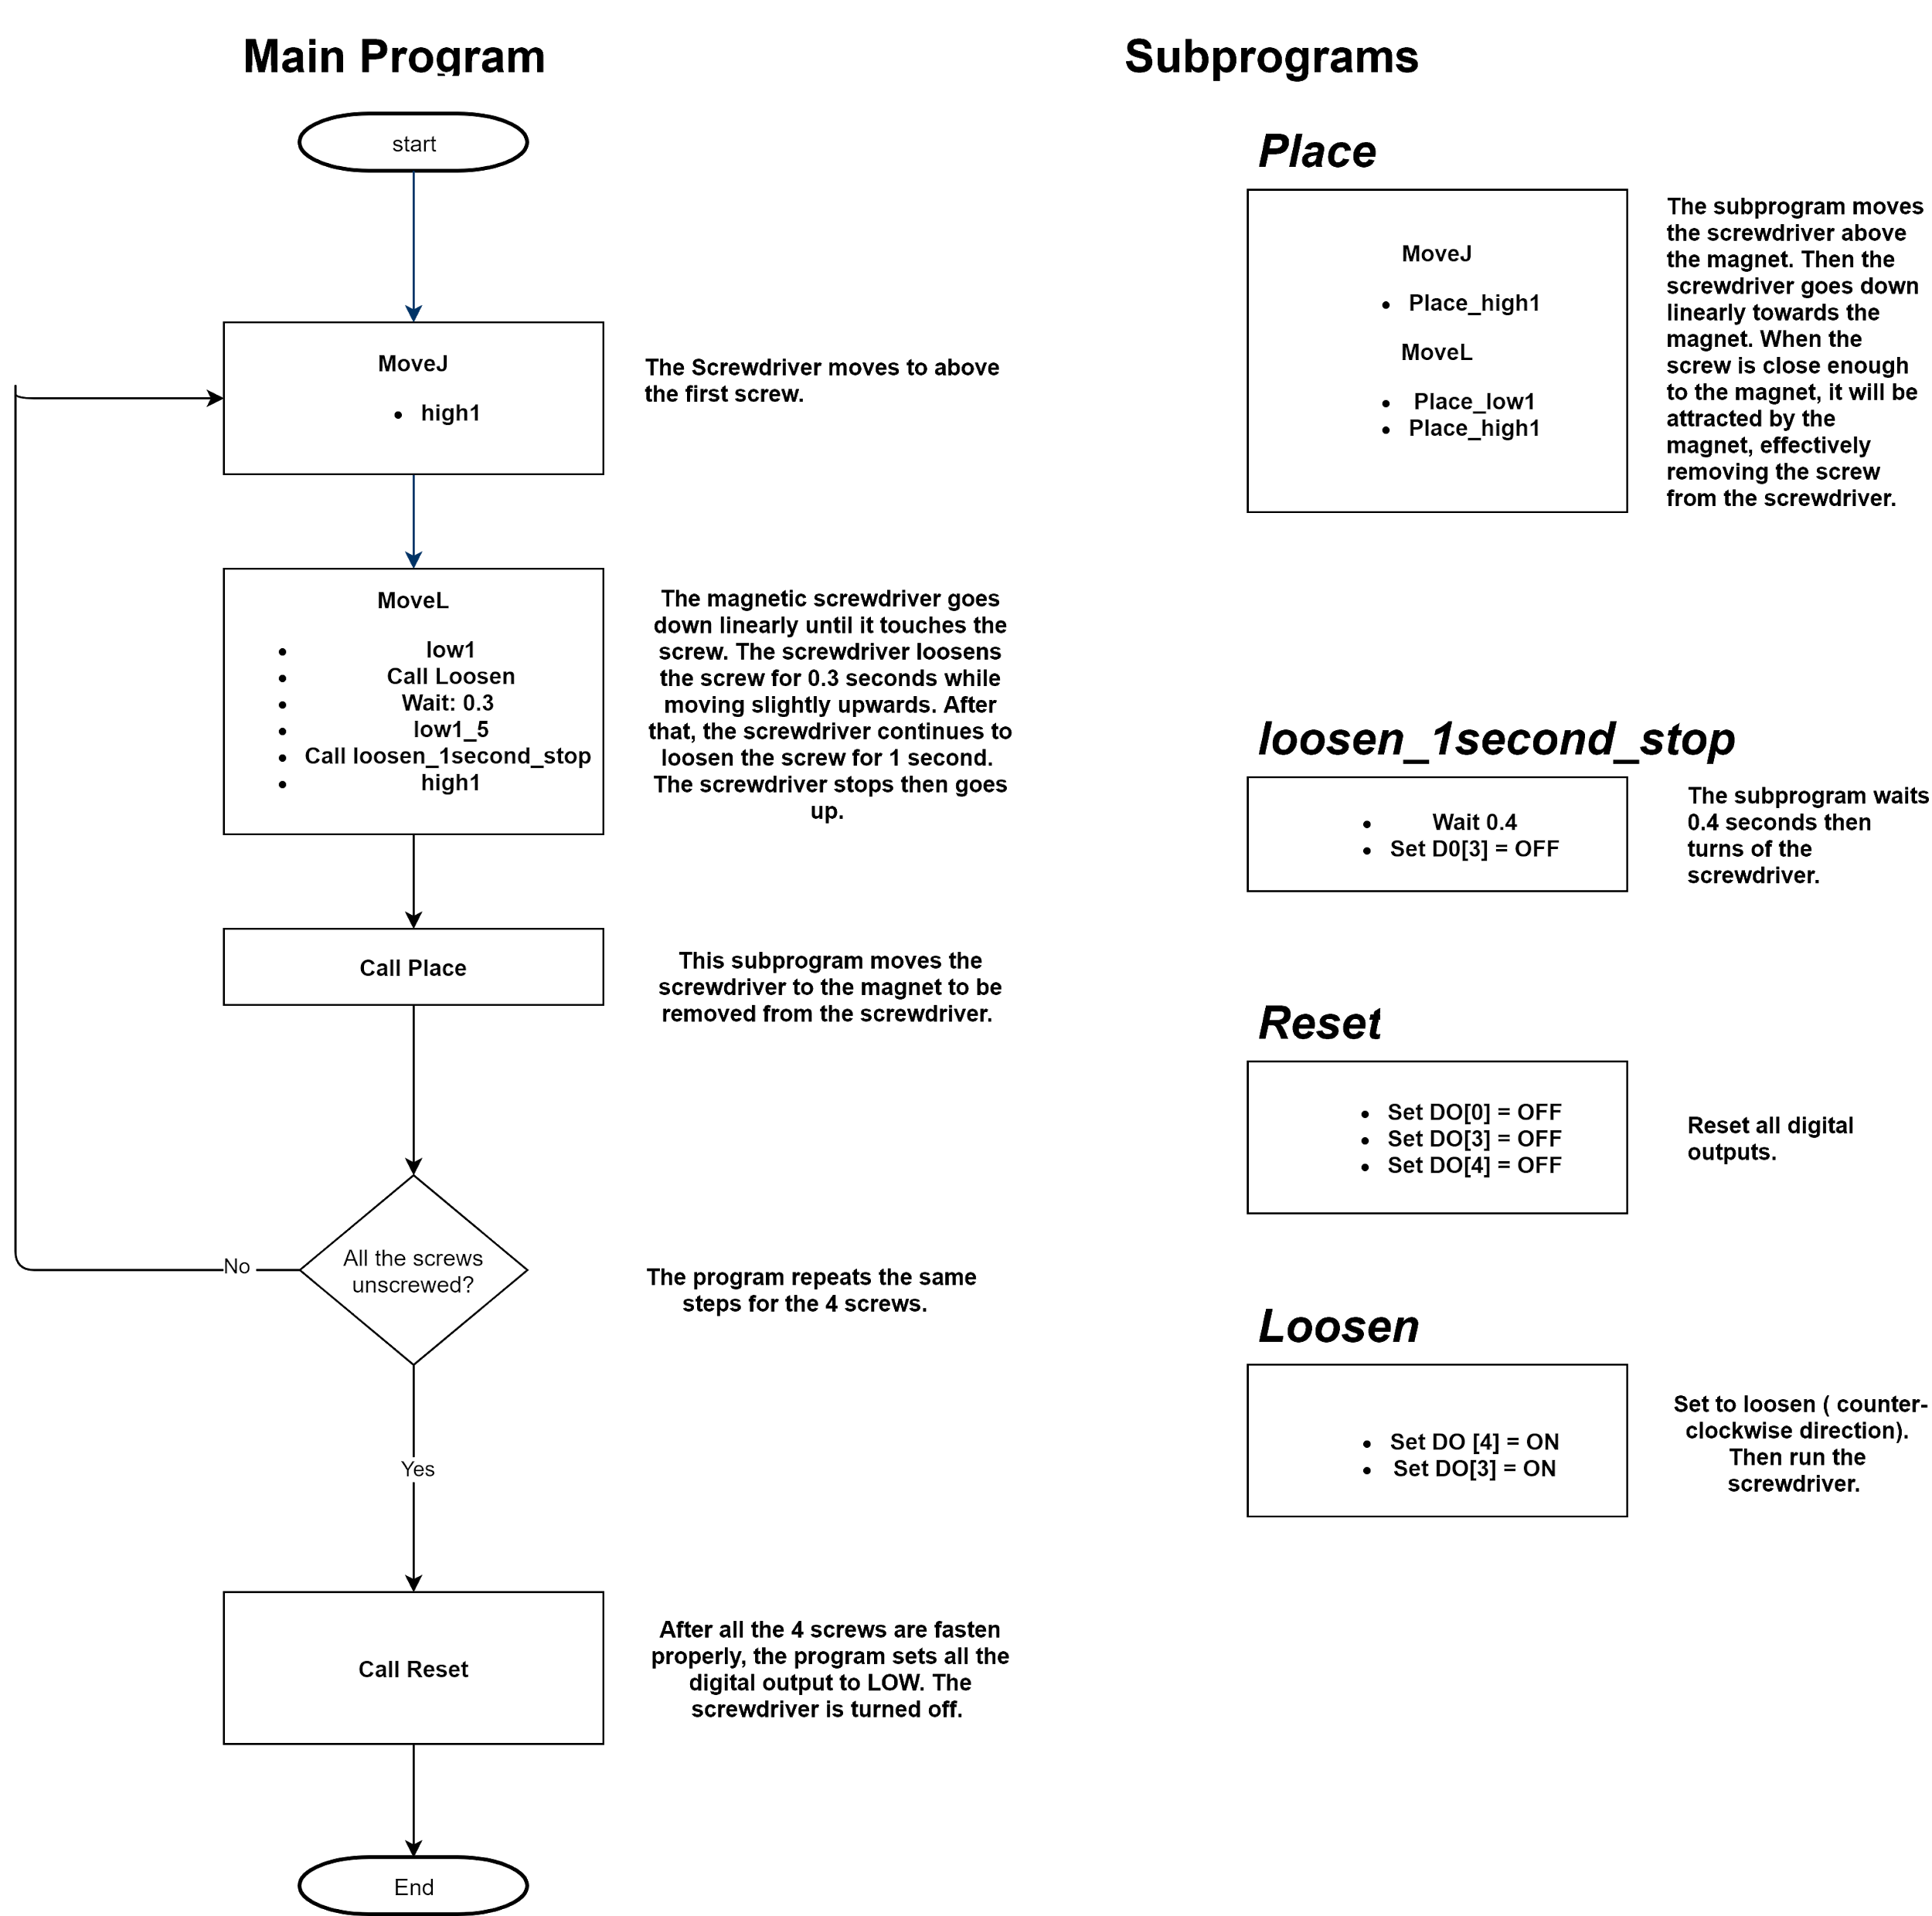
Program 2 unscrew 4 screws from PC case.

Slide 21
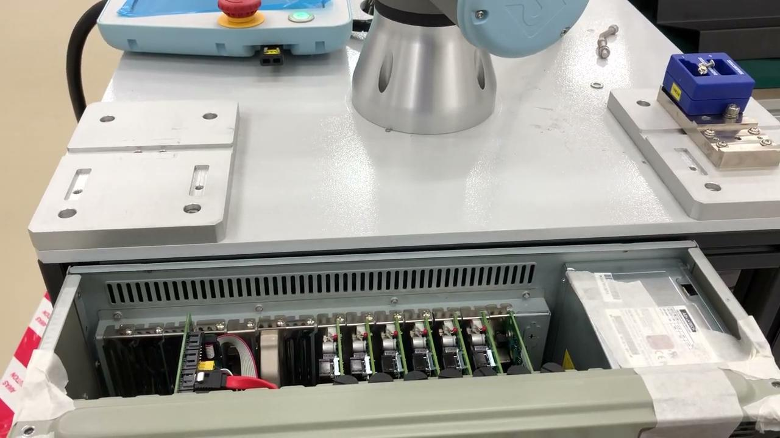
Program 2 Demo

Slide 22

Safety features
Protective stop
Safety Boundary
Tool Sphere

Slide 23
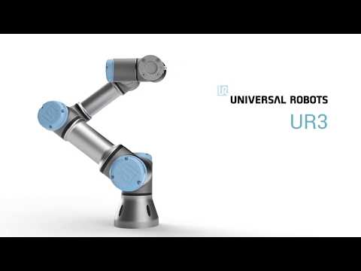
Protective stop
Stops immediately when it hits an object

Slide 24
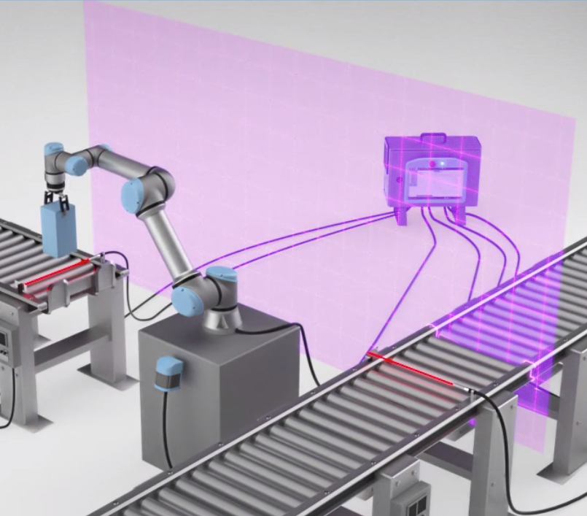
Safety Boundary
Able to create a boundary which is off limit to the robotic arm

Slide 25
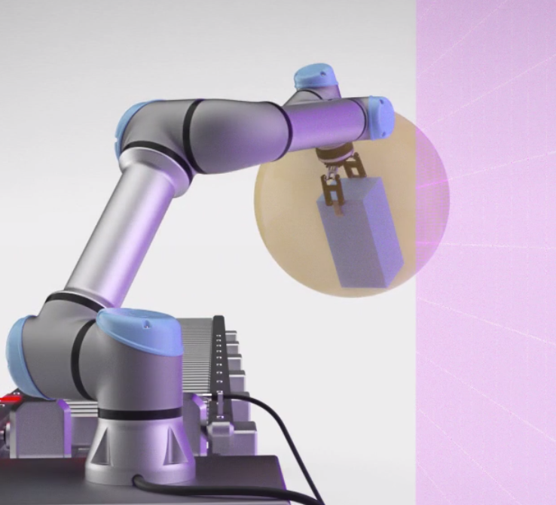
Tool Sphere
The robotic arm joints will avoid the tool sphere.
The tool sphere will not cross safety boundaries

Slide 26
Pros and Cons
Pros:
Accurate
Variable speed control
Save time
Good at repetitive tasks
A lot of programmable functions and connectivity
Great safety features
Compact
Cons:
High cost of robot and automatic spindle
Optimizes and automates some specific operation processes but not all
UR3 is a smaller cobot which means it’s range is also limited
Notes:
Accuracy of 0.1mm. Able to work alongside humans, unlike traditional industrial robots which have less safety features which result in higher risk of injury. Traditional industrial robots have to be operated within safety cages or fencing directly alongside people. Cobots like UR is very flexible and compact.

Slide 27
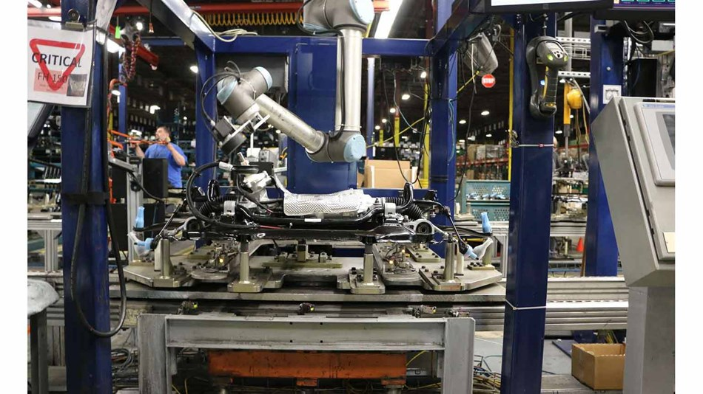
Application
Main Goal: Improved efficiency and safety to improve production
Material Handling
Dangerous especially metal, plastic and other substances
Repetitive tasks give rise to repetitive muscle strain injury
Heavy materials can be lifted and moved
Assembly and quality assurance
Welding small pieces together
Drilling screws
Camera Vision
Material Removal
Filling molds
Trimming excess metal or plastic
Polishing
Dispensing glue and other adhesives

Slide 28

Q&A Session

Slide 29
THE END
THANK YOU

